Slide 1

Rhetoric to Reality: looking to forward to 2010 and beyond
Preparatory Committee for the
2010 Nuclear Non-Proliferation Treaty
Review Conference
4 – 15 May 2009 in New York
Third Session
Comments by Natasha Barnes, to the
National Consultative Committee on Disarmament
Monday 25th of May, 2009

Slide 2
‘In a strange turn of history, the threat of global nuclear war has gone down, but the risk of a nuclear attack has gone up…. as more people and nations break the rules, we could reach the point where the center cannot hold.’
‘So today, I state clearly and with conviction
America's commitment to seek the peace and security of
a world without nuclear weapons’
‘The US will take concrete steps towards
a world without nuclear weapons’
President Obama, 5th April 2009 Prague

Slide 3
‘a new Strategic Arms Reduction Treaty with the Russians’
‘Reduce the role of nuclear weapons in our national security strategy, and urge others to do the same. ‘
‘U.S. ratification of the Comprehensive Test Ban Treaty’
‘A new treaty that verifiably ends the production of fissile materials intended for use in state nuclear weapons.’
‘Authority to strengthen international inspections…. And consequences for countries caught breaking the rules or trying to leave the treaty without cause.’
‘framework for civil nuclear cooperation, including an international fuel bank’
Resolution of Iranian and North Korean non compliance
Proliferation Security Initiative , Global Initiative to Combat Nuclear Terrorism
‘Global Summit on Nuclear Security … within the next year.’

Slide 4
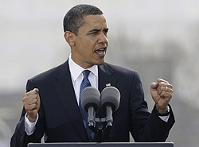
The
OBAMA MOMENT
A critical mass?
The ‘Obamajority’

Slide 5
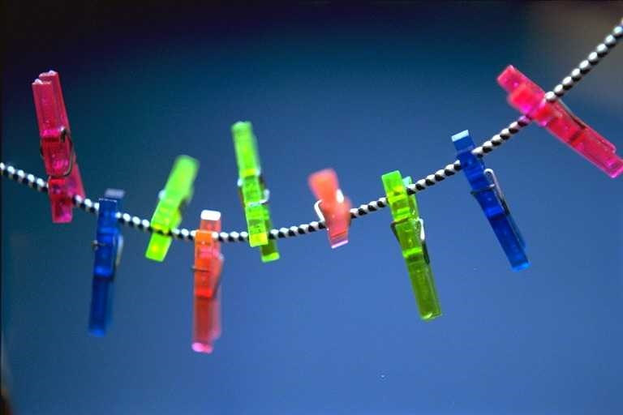
To name a few….
  Percovitch/ Acton: abolishing Nuclear Weapons
  Abolition 2000
  Article VI Forum
  Global Zero
    Shultz, Kissinger, Nunn and Perry: Hoover Plan
    Additional ‘horsemen’
    ICAN
    Luxembourg Forum
    Blix Commission
    2020 Campaign
      13 Steps
      Obama in Prague 5th April
      Medvedev/ Obama joint statement
  EU disarmament Initiative
  UN Secretary General’s Five Point Plan
  Japnese Intiative: Renew Determination
  UK: Lifting the Shadow
  Norwegian Initiative (7NI)

Slide 6


A Moment for Caution
‘Make no mistake: As long as these weapons exist, the United States will maintain a safe, secure and effective arsenal to deter any adversary, and guarantee that defense to our allies’
‘This goal will not be reached quickly -- perhaps not in my lifetime.’
‘….continuing value in deterring war as well as new threats to national security which may emerge’ (Brown)

Slide 7
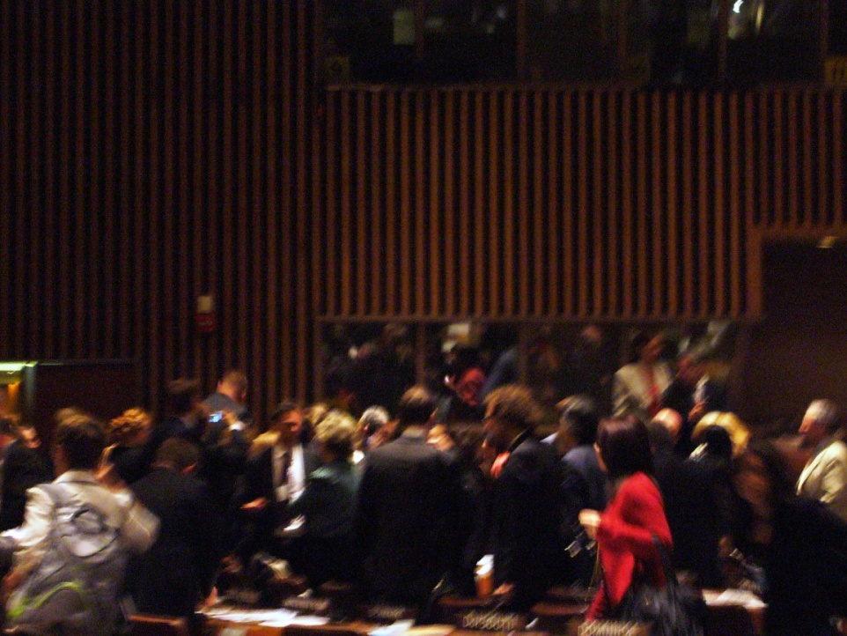
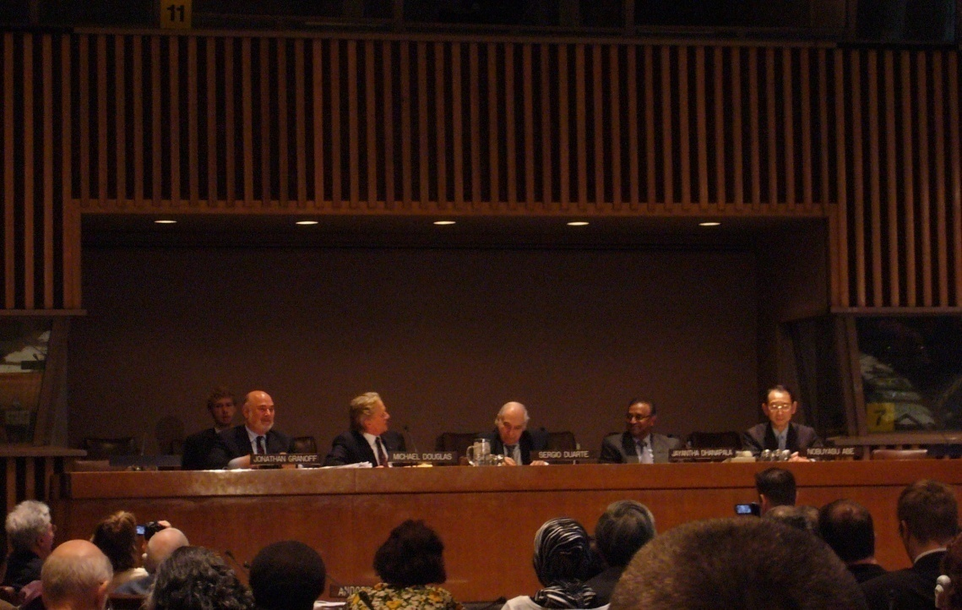
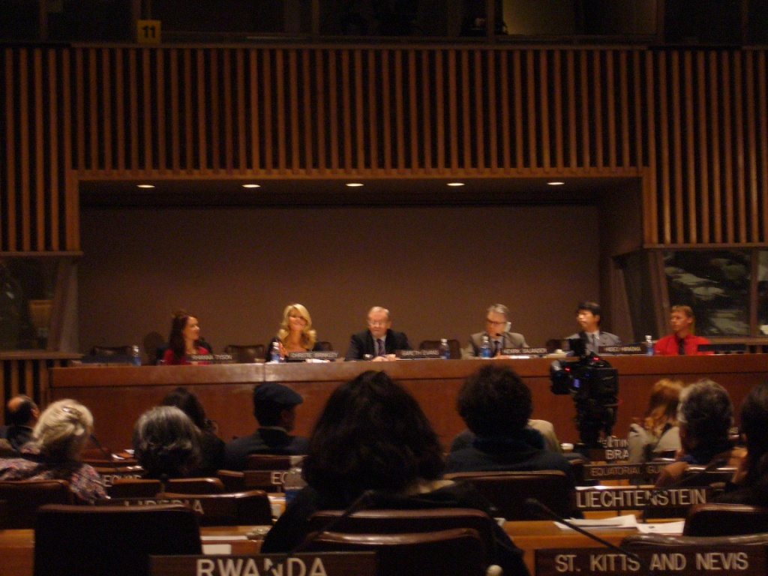
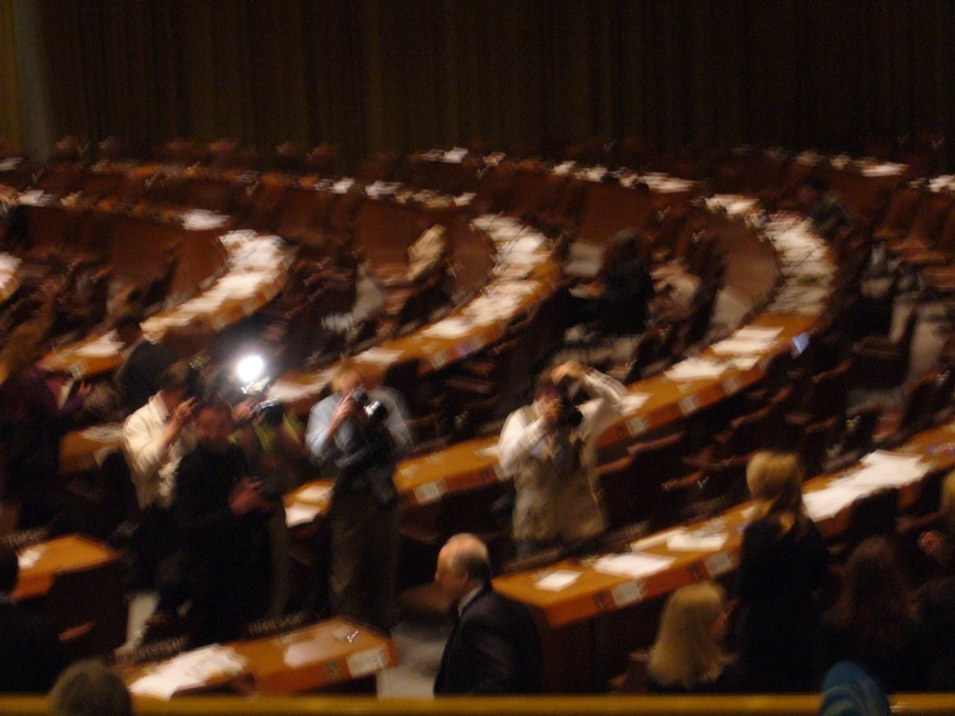
NGO initiatives and contributions
Star power: new energy in the debate

Slide 8
NGO contributions and initiatives
Side sessions and comments at the Prep Com
•
ICNND
VERTIC
Disarmament and human security
Nuclear Weapons Convention
Nuclear Weapons Convention Student Simulation
Disarmament Education
US Nuclear Posture Review
NATO Strategic Concept (Review)
IRENA: International Renewable Energy Agency
Environmental and medical consequences of nuclear war: climate change models
NEA NWFZ
Towards a Nuclear Weapons Free World: Indian perspective
•
•
•
•
•
•
•
•
•
•
•

Slide 9
Options: to address use or threat of use
Amendment to the Rome Statute
Nuclear Weapons Convention
Short treaty on the legality of the threat or Use (Ottawa/ Oslo style Process )
A new World Court Project
UNSC resolution

Slide 10
Things to think about
The steps identified need to be transformed into an action plan
‘Doublethink’ needs to be addressed
Communication between stakeholders
Issue of conventional superiority needs to be addressed
Security post nuclear weapons
Need to create an irresistible political situation
Disarmament education

Slide 11
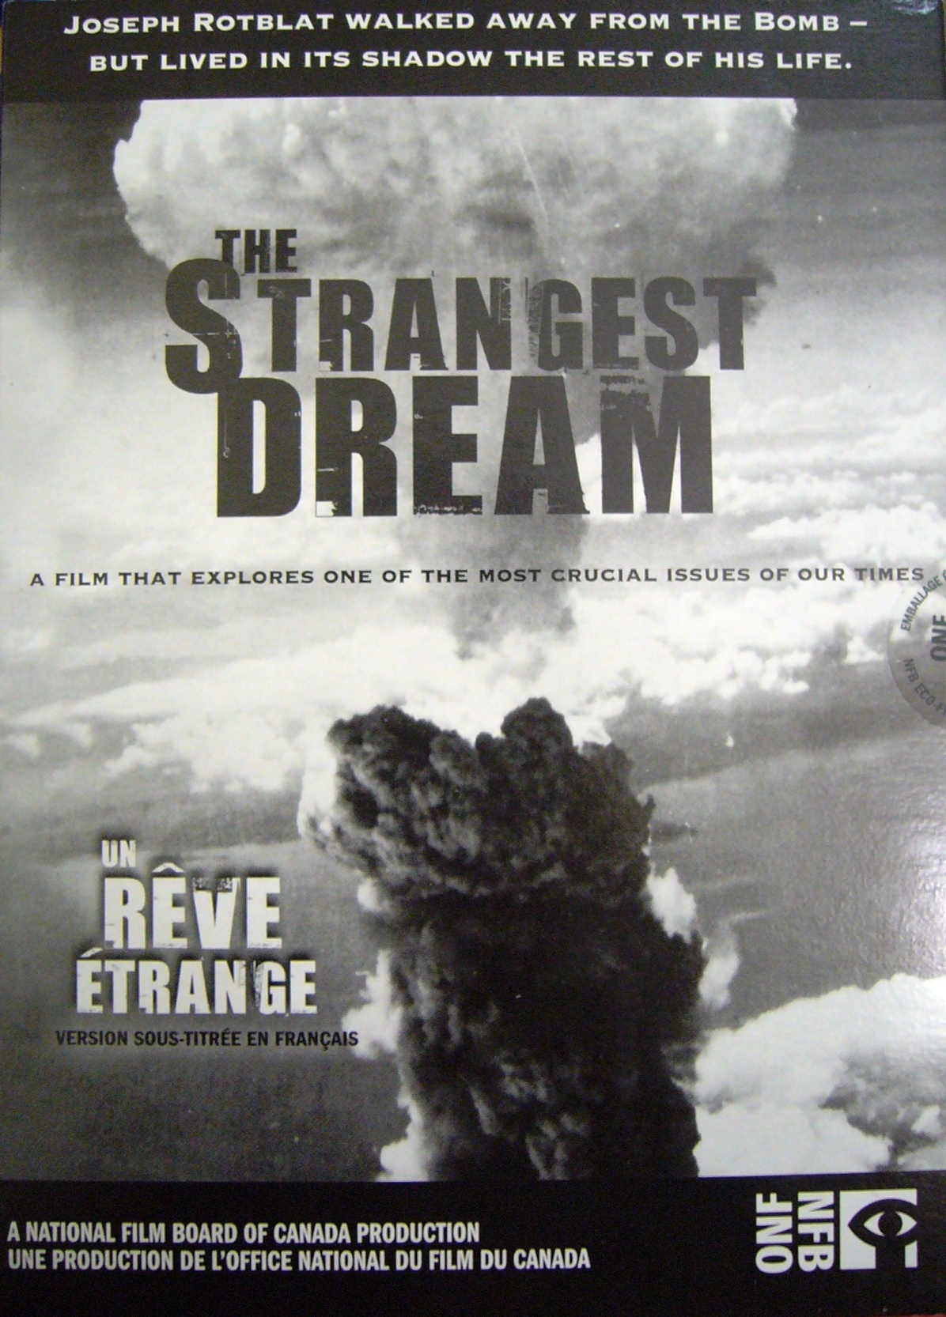
‘Last night I had the strangest dream I'd ever dreamed before ,
I dreamed the world had all agreed
To put an end to war.
I dreamed I saw a mighty room Filled with women and men
And the paper they were signing said
They'd never fight again
And when the paper was all signed
And a million copies made,
They all joined hands and bowed their heads,
And grateful pray'rs were prayed’

Slide 12
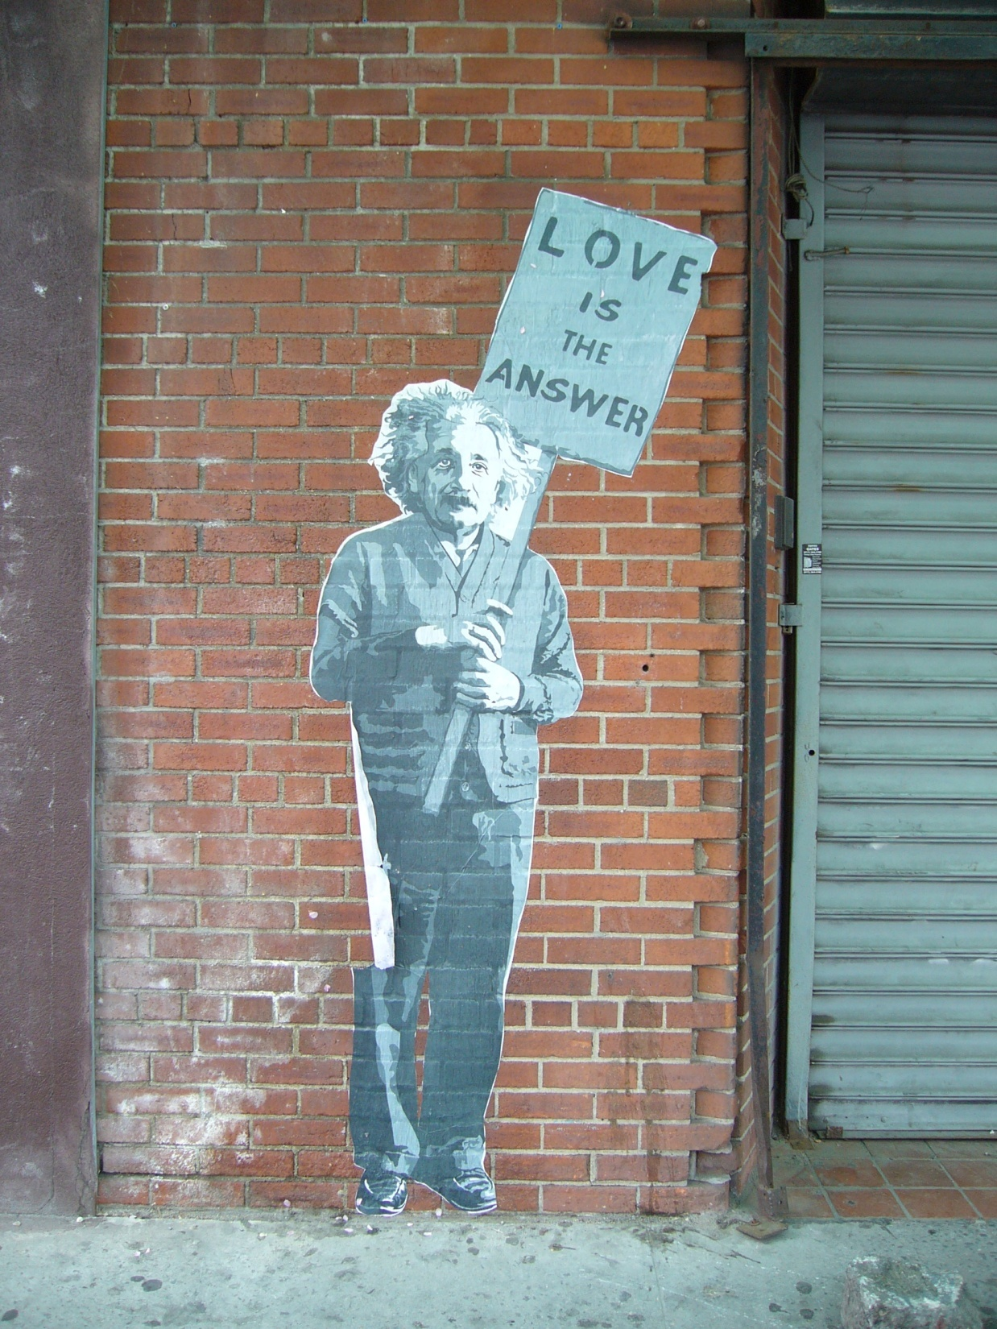
The unleashed power of the atom has changed everything save our modes of thinking. The solution to this problem lies in the heart of mankind’

Slide 13
Sources and Resources
Proposals, Position and Prospects: Issues Facing the 2010 NPT Review Conference, Towards 2010 and Beyond, Disarmament Diplomacy, URL: http://www.acronym.org.uk/dd/dd90/90nptms.htm
NPT News in Review: Civil Society Perspectives on the third Preparatory Committee for the 2010 nuclear Non Proliferation Treaty Review Conference 4-15 May, 2009, URL: http://www.reachingcriticalwill.org/legal/npt/nirindex.html#2009
http://www.nucleardarkness.org

Slide 14
Other issues
Conventional weapon assymetry
Energy and climate change, and the nucelar industry
India/Pakistan
Pakistan/ Teleban
Middle Eastern Peace Process
National Missile Defence
Outer Space

Slide 15
Major subjects of discussion
Multilateral fuel Cycle
[explain]
The ME and a NWFZ
[explain]
The possibilities for a SEA NWFZ
[explain]
The NWC
[explain]
NATO
Nuclear Sharing, position of nucelar 3wepaons in strategic posture

